Slide 1

Campus Event Management System (CEMS)
Name: Maaz Mustafa Khan Roll#cs251234
Junaid Ahmed Roll#cs251007
Rayyan Sohail Roll#cs251023

Slide 2

Working Of Program
Dual-Portal System: Independent login environments for student registration and administrative management.
File-Based Persistence: Permanent storage of events, bookings, and feedback using local .txt files.
Alphanumeric Validation: Secure 8-character ID verification to ensure authentic student entry.
Automated Seat Allocation: Dynamic generation of random seat numbers upon successful enrollment.
Administrative Control: Password-protected access with a 3-attempt lockout for system security.
Simulated Enrollment: Integrated logic for fee verification and real-time registration updates.

Slide 3
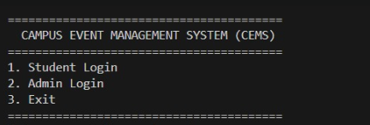
This is starting display of the program.
You are provided with dual login system 1st as a student and 2nd as admin.

Slide 4

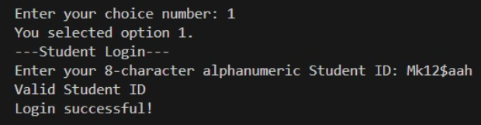
The student login will be followed by asking an 8-character alphanumeric id to validate student’s identity, unable to provide correct student id will cause in termination of the program.

Slide 5
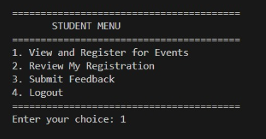
After student validation, you are provided with list of options related to the ongoing events.

Slide 6
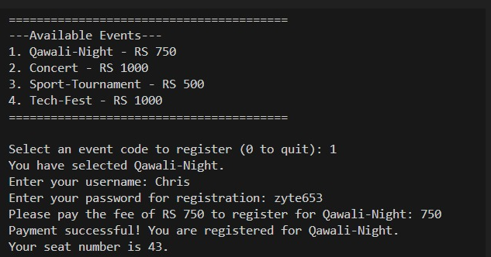
After selecting first option to register for event you are provided with different ongoing events to register for and their fees.
To register you have to provide your name password, event fee after which you will be registered for the event, and a seat number will be provided and all these info will be stored in a .txt file.

Slide 7
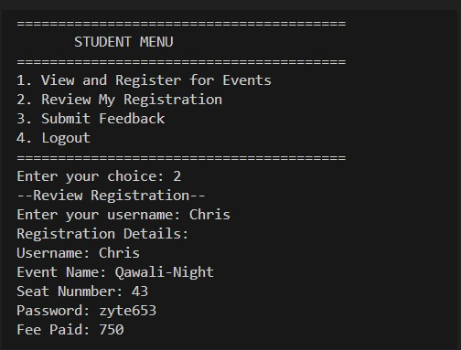
After selecting option 2 you can review your registration for the specific event which will show all the details of your registered event, if you haven’t registered for any event, you will be met with an error.

Slide 8
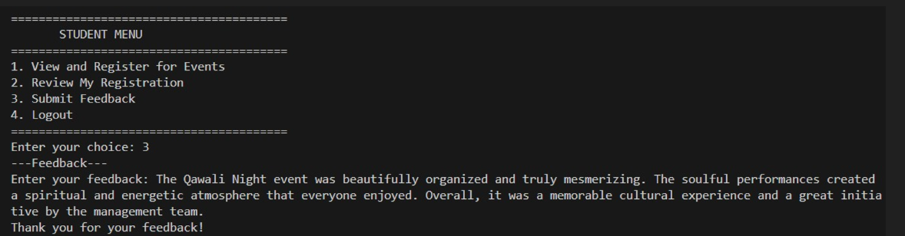
By selecting option 3 you can submit your feedback (which will be anonymous) about the event which will we stored in a .txt feedback file.

Slide 9
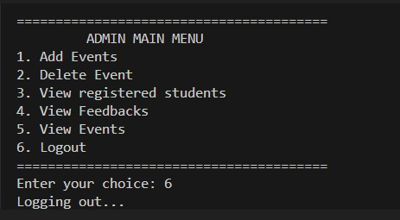
Option 4 will simply allow you to logout by terminating the program

Slide 10
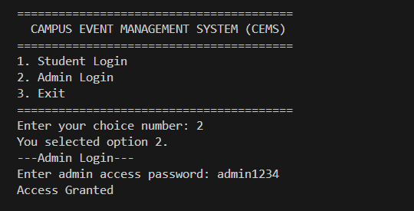
Logging in as an admin will require you to authenticate yourself with a password which is stored in adminpass.txt file where it will compare the provided pass to stored pass to grant access to admin panel.

Slide 11
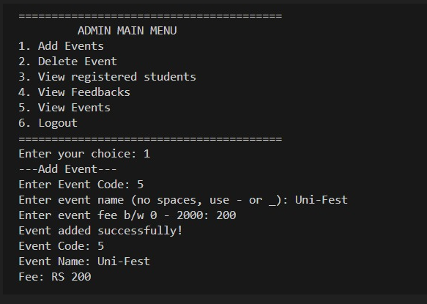
After authentication you are displayed with admin panel where you can perform different operation for e.g. add event.
You must provide event name, code and fees.

Slide 12
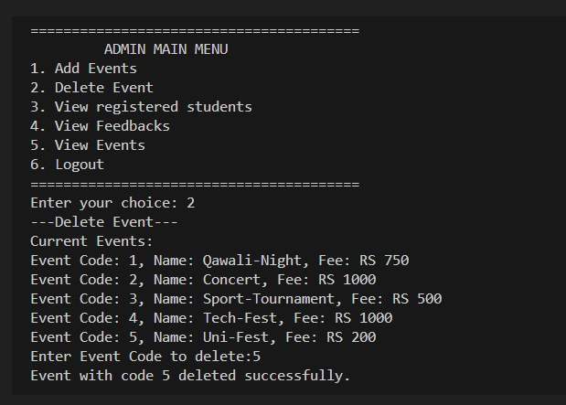
You are also provided with an option to delete specific event where you must enter the code of the event to perform such action.

Slide 13
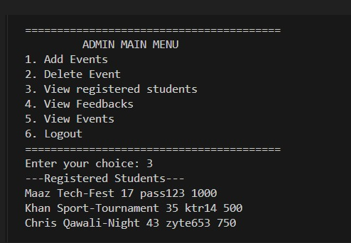
You can also view all the registered students for specific events and their details.

Slide 14
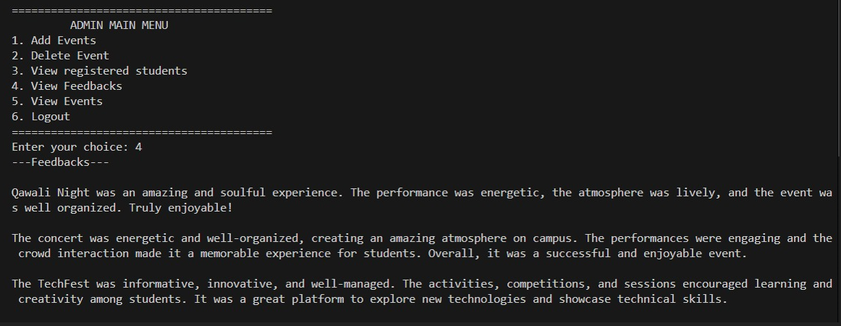
Option 4 will allow you to view all the stored feedbacks provided by the students.

Slide 15
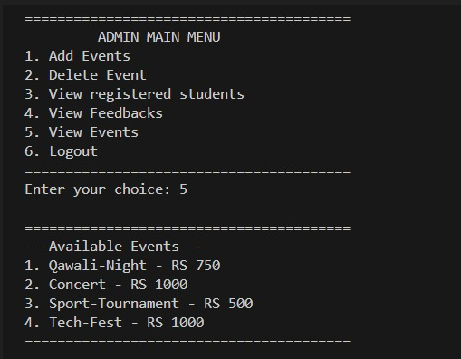
Admin can also view the ongoing events by selecting option 5 and option 6 will simply allow admin to logout by terminating the program.

Slide 16
The End

